Slide 1
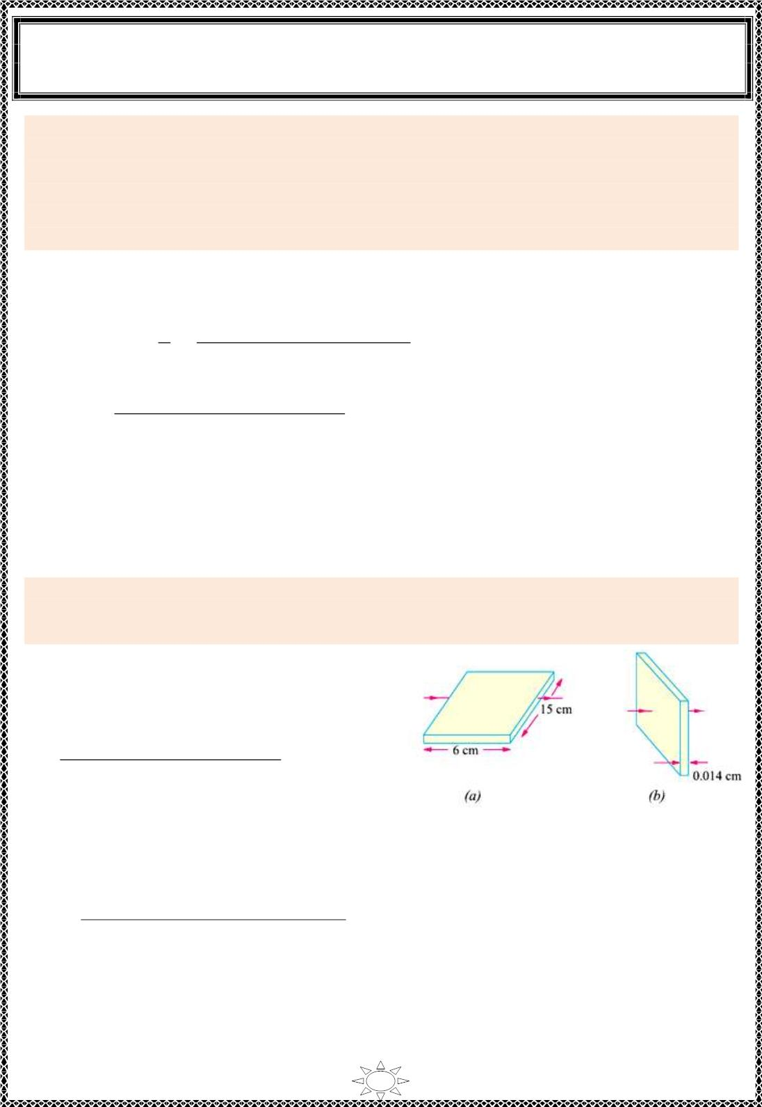
University of Diyala
Engineering College
Electronic Department
Electrical Engineering Fundamentals
1st Class
Asst., Lecturer : Wisam N. AL-Obaidi
Year (2013-2014)
Example 9: (a) A rectangular carbon bloc k has dime ns ions 1.0 cm × 1.0 cm × 50 cm.
(i) What is the resistance measured between the two square ends ? (ii) between two
−5
opposing rectangular faces / Resistivit y of carbon at 20°C is 3.5 × 10 Ω-m.
(b) A current of 5 A exists in a 10-Ω resistance for 4 minutes (i) how many coulombs and
(ii) how many electrons pass through any section of the resistor in th is time ? Charge of
−19
the electron = 1.6 × 10 C.
Solution:
(a) (i)
2
−4
2
A = 1 × 1 = 1 cm = 10 m ; l = 0.5 m
푙
−5
∴ R = R = ρ
(3.5 ×10
훺.푚 ) ×(0.5 푚)
퐴
=
−4
2
= 0.175 Ω
10
푚
2
−3
2
(ii) l = 1 cm; A = 1 × 50 = 50 cm = 5 × 10 m
R =
(3.5 ×10⁻⁵ 훺.푚) ×(10⁻² 푚 )
= 7 × 10⁻⁵ Ω
5 × 10⁻³ 푚²
(b) (i) Q = It = 5 × (4 × 60) = 1200 C
(ii) n = Q / e = 1200 / (1.6 × 10⁻¹⁹) = 75 × 10²⁰
Trail Version
Trail Version
Trail Version
Trail Version
Trail Version
Trail Version
Trail Version
Trail Version
Trail Version
Trail Version
Trail Version
Trail Version
Trail Version
Example 10: The res is tivit y of a ferric-chromium-aluminium alloy is 51 × 10⁻⁸ Ω-m. A
sheet of the material is 15 cm long, 6 cm wide and 0.014 cm thick. Determine resistance
between (a) opposite ends and (b) opposite sides.
Solution:
(a) As seen from Figure (1.8)(a) in th is case,
l = 15 cm = 0.15 cm
A = 6 × 0.014 = 0.084 cm = 0.084 × 10 m
2
−4
2
R =
( 51 ×10⁻⁸ 훺.푚) ×(0.15 푚 )
−4
푚²
0.084 × 10
−3
= 9.1 × 10 Ω
(b) As seen from Figure (1.8)(b) here
Figure (1.8)
−5
l = 0.014 cm = 14 × 10 m
2
−3
2
A = 15 × 6 = 90 cm = 9 × 10 m
∴ R =
(51 ×10⁻⁸ 훺.푚) ×(14 × 10⁻⁵푚)
= 79.3 × 10⁻¹⁰ Ω
9 × 10⁻³ 푚²
11

Slide 2
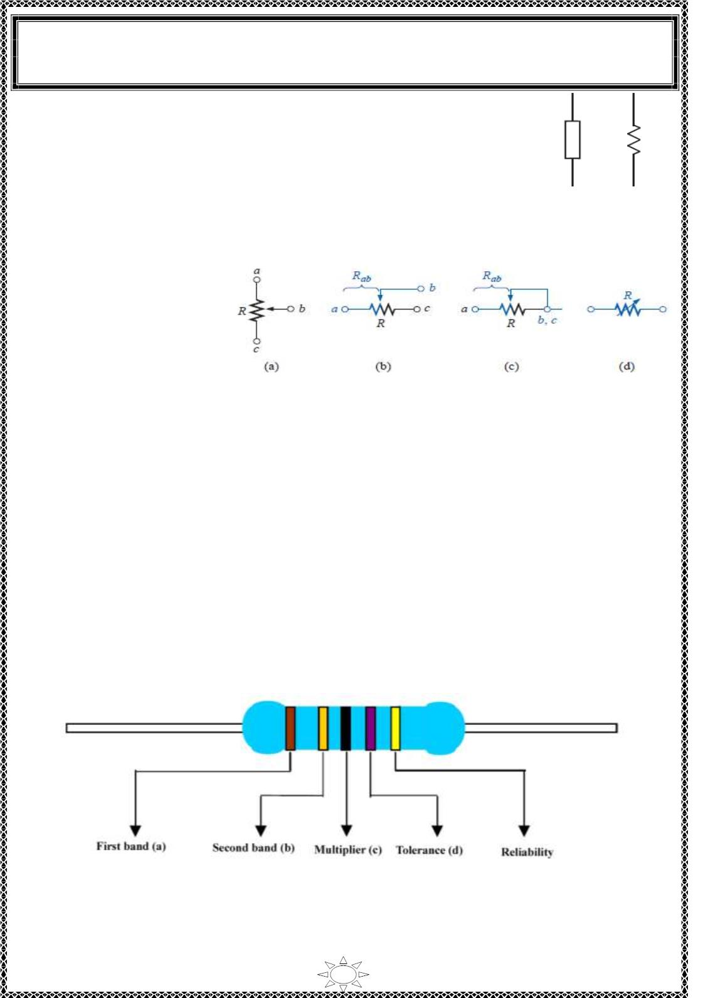
University of Diyala
Engineering College
Electronic Department
Electrical Engineering Fundamentals
1st Class
Asst., Lecturer : Wisam N. AL-Obaidi
Year (2013-2014)
FIXED RESISTORS
A fi xed resistor is one that has a s ing le value of resistance whic h
remains constant under normal conditions . The two main types of
fixed resistors are carbon-composition and wire-wound resistors.
Figure (1.9 )
VARIABLE RESISTORS
Var iab le res istors are used
to vary or change the
amount of res istance in a
c irc uit. Variable resistors
are called potentiometers
or rheostats.
Figure (1.10)
Color Coding of Resistors
Trail Version
Trail Version
Trail Version
Trail Version
Trail Version
Trail Version
Trail Version
Trail Version
Trail Version
Trail Version
Trail Version
Trail Version
Trail Version
Large res istors such as the wire-wound resistors or the ceramic-encased power resistors
have t heir resistor values and tolerances printed on their cases. Smaller res istors, whether
constructed of a mo ld ed carbon composition or a metal film, may be too small to have
their values printed on the component. Instead, these smaller res istors are usually covered
by an epoxy or similar insulating coat ing over whic h several colored bands are printed
radially as shown in Figure below.
The colored bands provide a quic kly recognizab le code for determining the value of
resistance, the tolerance (in percentage), and occas ionally the expected reliability of the
resistor. The colored bands are always read from le ft to r ight, left be ing defined as the side
of the resistor wit h the band near est to it.
Figure (1.11): Color code resistor
12

Slide 3
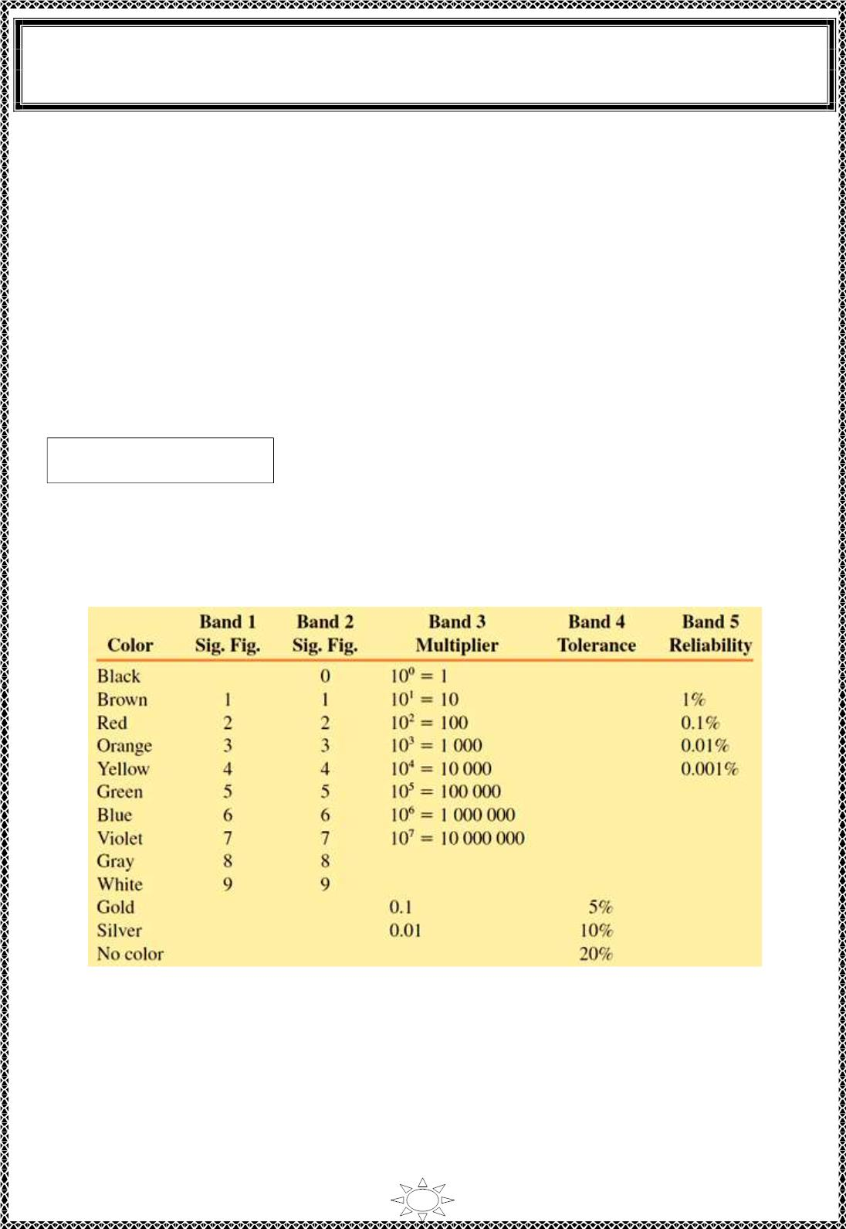
University of Diyala
Engineering College
Electronic Department
Electrical Engineering Fundamentals
1st Class
Asst., Lecturer : Wisam N. AL-Obaidi
Year (2013-2014)
The first two bands represent the first and second d ig its of the resistance value. The third
band is called the multiplier band and represents the number of zeros fo llo win g the first
two digits ; it is usually given as a power of ten.
The fourth band ind icates the tolerance of the resistor, and the f ifth band (if present) is an
indicat ion of the expected reliab ilit y of the component. The reliability is a statistical
indicat ion of the expected number of components which will no longer have the indicated
resistance va lue after 1000 hours of us e. For example, if a part icular resistor has a
reliab ilit y of 1% it is expected that after 1000 hours of use, no more than one res istor in
100 is likely to be outside the specif ied range of resistance as ind icated in the first four
bands of the color codes.
Color band resistor can be evaluated using the following relation,
R_{color} = ab × 10^{c ±}
d
Tab le (1.6) shows the colors of the various bands and the corresponding values.
Tab le (1.6): Resistor Color Code
Trail Version
Trail Version
Trail Version
Trail Version
Trail Version
Trail Version
Trail Version
Trail Version
Trail Version
Trail Version
Trail Version
Trail Version
Trail Version
13

Slide 4
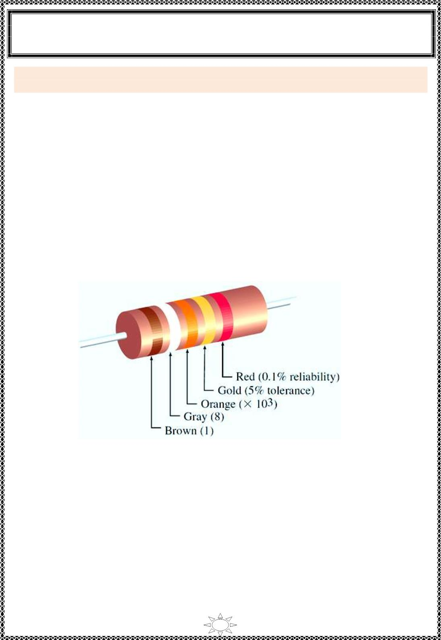
University of Diyala
Engineering College
Electronic Department
Electrical Engineering Fundamentals
1st Class
Asst., Lecturer : Wisam N. AL-Obaidi
Year (2013-2014)
Example 11: Determine the resistance of a carbon film resistor having the color codes
shown in Figure (1.12).
Solution:
From Tab le (1.6), we see that the res istor will have a value determined as,
^{c} ±
R_{color} = ab × 10
d
= 18 × 10^{3 ±} 5%
= 18 kΩ± (0.05 × 18 kΩ)
= 18 kΩ± (0.9 kΩ) with a reliab ilit y of 0.1%
∴ R = 18 + 0.9 = 18.9 kΩ
Or R = 18 – 0.9 = 17.1 kΩ
This specificat ion indicates that the res istance will fall between 17.1 kΩ and 18.9 kΩ.
After 1000 hours, we would expect that no more than 1 res istor in 1000 would fall outside
the specified range.
Trail Version
Trail Version
Trail Version
Trail Version
Trail Version
Trail Version
Trail Version
Trail Version
Trail Version
Trail Version
Trail Version
Trail Version
Trail Version
Figure (1.12)
14

Slide 5
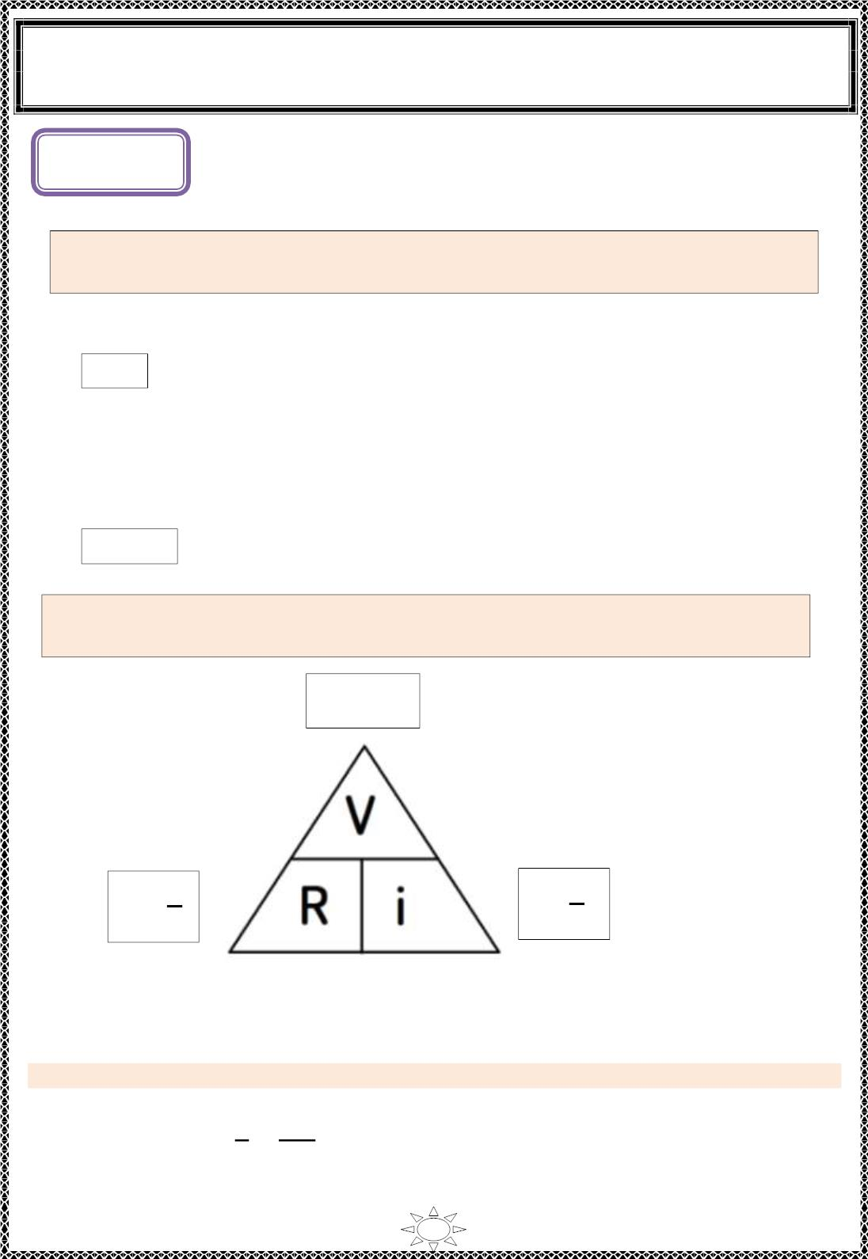
University of Diyala
Engineering College
Electronic Department
Electrical Engineering Fundamentals
1st Class
Asst., Lecturer : Wisam N. AL-Obaidi
Year (2013-2014)
L ectur e (2)
Ohm’s law
Ohm‘s law states that the voltage v across a resistor is directly proportional
to the current i flowing through the resistor.
That is,
v α i
…(1)
Ohm defined the constant of proportionality for a resistor to be the resistance, R. (The
resistance is a material property which can change if the internal or external condit ions of
the element are altered, e.g., if there are changes in the temperature.) Thus, Eq. (1)
becomes
v = iR
…(2)
Trail Version
Trail Version
Trail Version
Trail Version
Trail Version
Trail Version
Trail Version
Trail Version
Trail Version
Trail Version
Trail Version
Trail Version
Trail Version
The res is tanc e R of an element denotes its ability to resist the flow of
electric current; it is measured in ohms (Ω).
V = iR
V
i
V
R
R =
i =
Figure (2.1): Ohm's law triangle
Example 1: an electric conductor draws 2 A at 120 V. Find the resistance.
Solution:
V
120
2
From Ohm's law, R = =
= 60 Ω
i
15

Slide 6
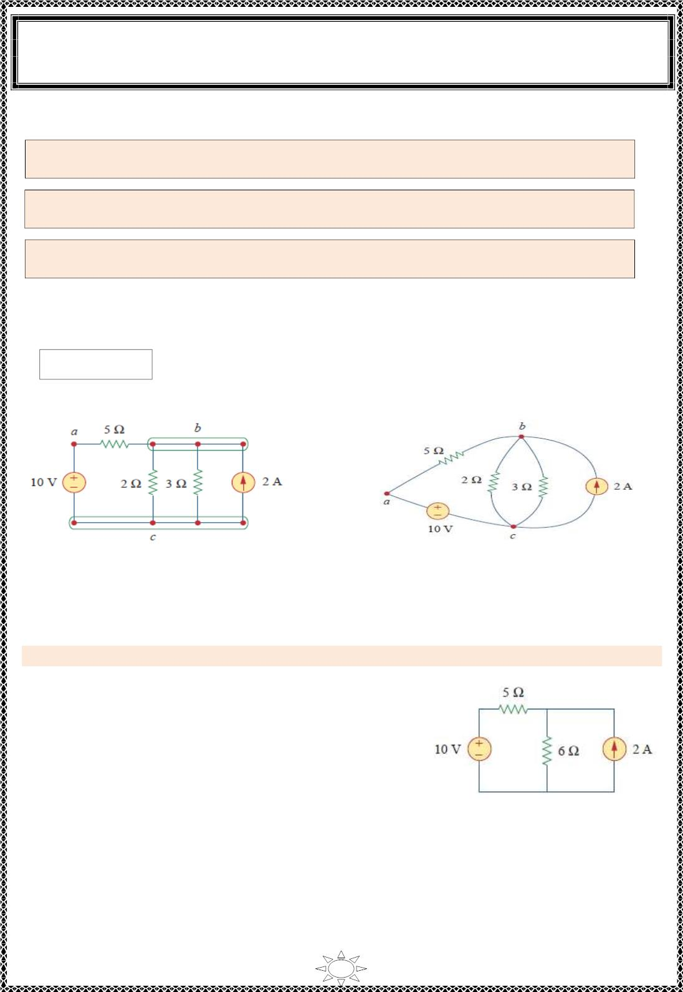
University of Diyala
Engineering College
Electronic Department
Electrical Engineering Fundamentals
1st Class
Asst., Lecturer : Wisam N. AL-Obaidi
Year (2013-2014)
Nodes, Branches, and Loops
A branch represents a single element such as a voltage source or a resistor.
A node is the point of connection between two or more branches.
A loop is any closed path in a circuit.
A network with (b) branches, (n) nodes, and (l) independent loops will sat isfy the
fundamental theorem of network topology:
b = l + n - 1
Trail Version
Trail Version
Trail Version
Trail Version
Trail Version
Trail Version
Trail Version
Trail Version
Trail Version
Trail Version
Trail Version
Trail Version
Trail Version
Figure (2.2)(a): Nodes, branches and loops
Figure (2.2)(b): The three nodes circuit of
Figure (2.2)(a) is redrawn.
Example 2: Determine the number of branches and nodes in the circuit shown b elo w.
Solution:
Independent loops (l) = 2.
Number of nodes (n) = 3.
b = l + n – 1 = 2+3-1= 4 branches
Figure (2.3)
16

Slide 7
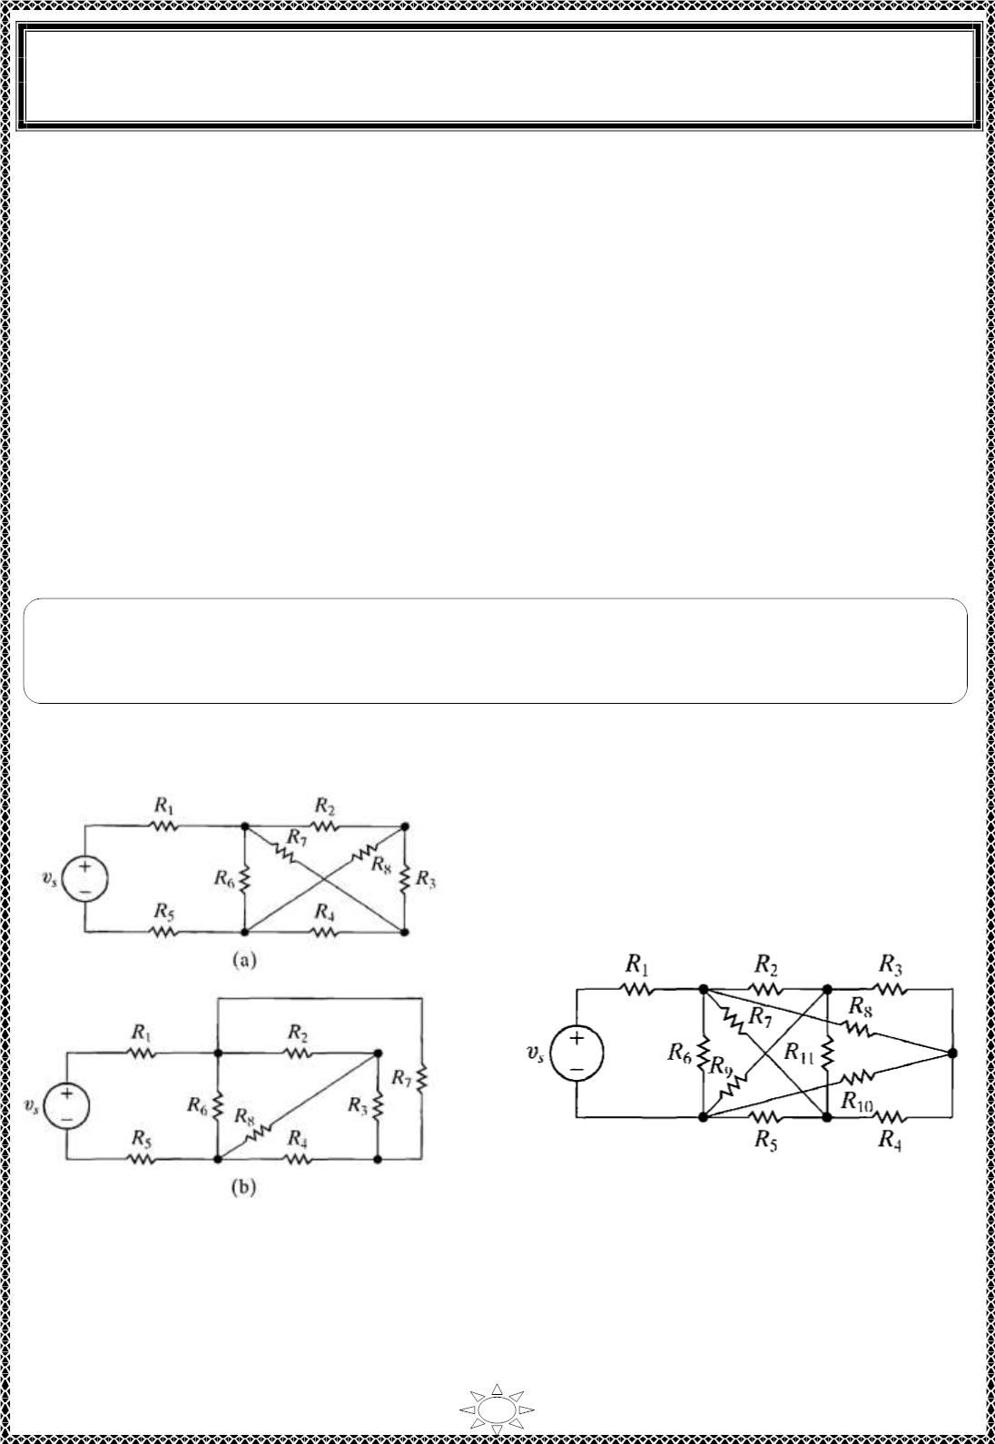
University of Diyala
Engineering College
Electronic Department
Electrical Engineering Fundamentals
1st Class
Asst., Lecturer : Wisam N. AL-Obaidi
Year (2013-2014)
Planar & non-planar Circuits
Planar circuits—that is, those c irc uits that can be drawn on a pla ne with no crossing
branches. A c irc uit that is drawn with crossing branches still is c ons idered planar if it can
be redrawn with no crossover branches. For example, the c ircuit shown in Figure (2.4) (a)
can be redrawn as Figure (2.4) (b); the c irc uits are equivalent because all the node
connections have been ma int a ined. Therefore, Figure (2.4 ) (a) is a planar c ircuit because it
can be redrawn as one.
A non-planar circuit—it cannot be redrawn in such a way that all the node connections
are maintained and no branches overlap as shown in Figure (2.5).
Note:- The node-voltage method is applic able to both pla nar and non-planar c ircuits,
Trail Version
Trail Version
Trail Version
Trail Version
Trail Version
Trail Version
Trail Version
Trail Version
Trail Version
Trail Version
Trail Version
Trail Version
Trail Version
whereas the mesh-current method is limited to planar circuits.
(a)A p lanar circuit (b) The same circuit
redrawn to verify that it is a planar
Figure (2.4)
Figure (2.5 )
17

Slide 8
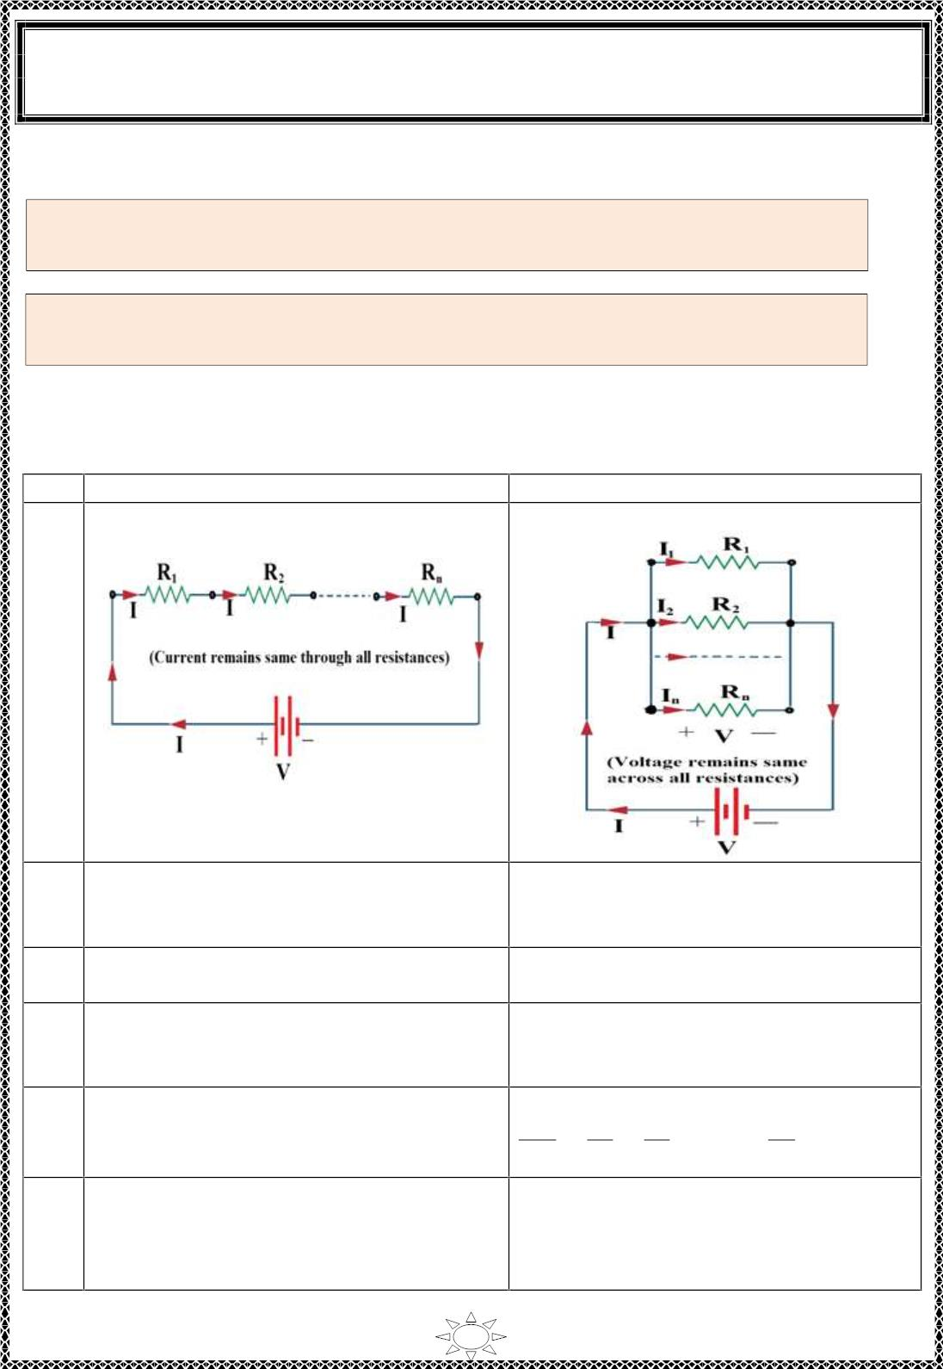
University of Diyala
Engineering College
Electronic Department
Electrical Engineering Fundamentals
1st Class
Asst., Lecturer : Wisam N. AL-Obaidi
Year (2013-2014)
Series and Parallel Resistances
Two or more elements are in series if they exclusively share a single node
and consequently carry the same current.
Two or more elements are in parallel if they are connected to the same two
nodes and consequently have the same voltage ac ros s them.
Table (2.1)
NO.
Series Circuit
Parallel Circuit
1
The connection is as shown
The connection is as shown
Trail Version
Trail Version
Trail Version
Trail Version
Trail Version
Trail Version
Trail Version
Trail Version
Trail Version
Trail Version
Trail Version
Trail Version
Trail Version
2
The same current f lows through each
resistance.
The same voltage exists across all the
resistances in parallel.
I = I = I = … = I
V = V = V = … = V
1
2
n
1
2
n
3
4
The voltage across each res is tanc e is
different.
The current through each resistance is
different.
The sum of the voltages across all the
resistances is the s upp ly vo ltage.
V = V + V + … + V
The sum of the currents through all the
resistances is the s upp ly current.
I = I + I + … + I
5
6
1
2
n
1
2
n
The equivalent resistance is,
R = R + R + … + R
n
The equivalent resistance is,
1
1
1
1
eq
1
2
R_{eq}
= + + … +
R
R
R_{n}
The equivalent resistance is the largest
than each of the resistances in ser ies.
R > R , R > R …, R > R
1
2
The equivalent resistance is the smaller
than the s malles t of all the resistances in
parallel.
eq
1
eq
2
eq
n
18

Slide 9
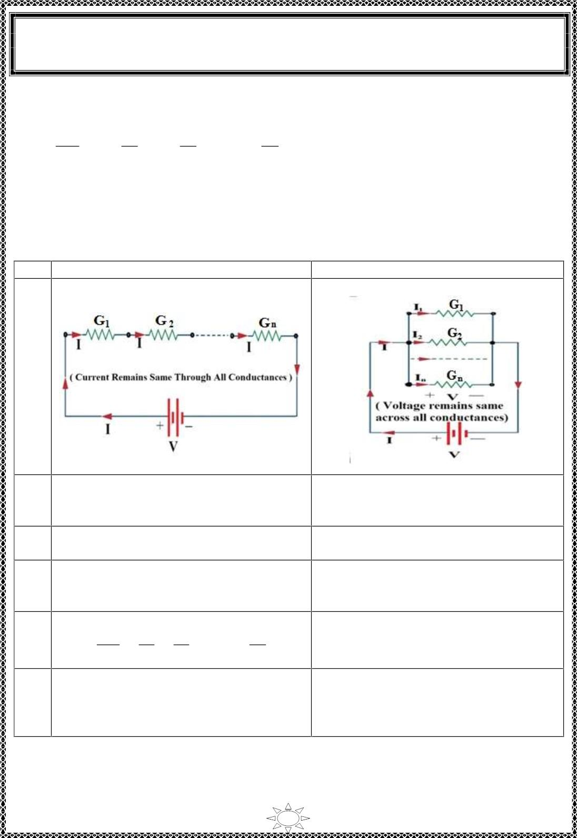
University of Diyala
Engineering College
Electronic Department
Electrical Engineering Fundamentals
1st Class
Asst., Lecturer : Wisam N. AL-Obaidi
Year (2013-2014)
Series and Parallel Conductances
G =
1
1
1
1
eq
R_{eq}
, G₁ =
, G = , …, G =
2 n
R₁
R
R_{n}
2
Table (2.2)
NO.
1
Series Circuit
The connection is as shown
Parallel Circuit
The connection is as shown
Trail Version
Trail Version
Trail Version
Trail Version
Trail Version
Trail Version
Trail Version
Trail Version
Trail Version
Trail Version
Trail Version
Trail Version
Trail Version
2
The same current f lows through each
conductance.
The same voltage exists across all the
conductances in parallel.
I = I = I = … = I
V = V = V = … = V
1
2
n
1
2
n
3
4
The voltage across each conductance is
different.
The current through each conductance is
different.
The sum of the voltages across all the
conductances is the s upp ly voltage.
V = V + V + … + V
The sum of the currents through all the
conductances is the s upp ly current.
I = I + I + … + I
5
6
1
2
n
1
2
n
The equivalent conductance is,
The equivalent conductance is,
1
1
1
1
G = G + G + … + G
G_{eq}
= + + … +
eq
1
2
n
G
G
G_{n}
1
2
The equivalent conductance is the smaller The equivalent conductance is the
than the s malles t of all the conductances largest than each of the conductances in
in p ara lle l.
series.
G > G , G > G …, G > G
eq
1
eq
2
eq
n
19

Slide 10
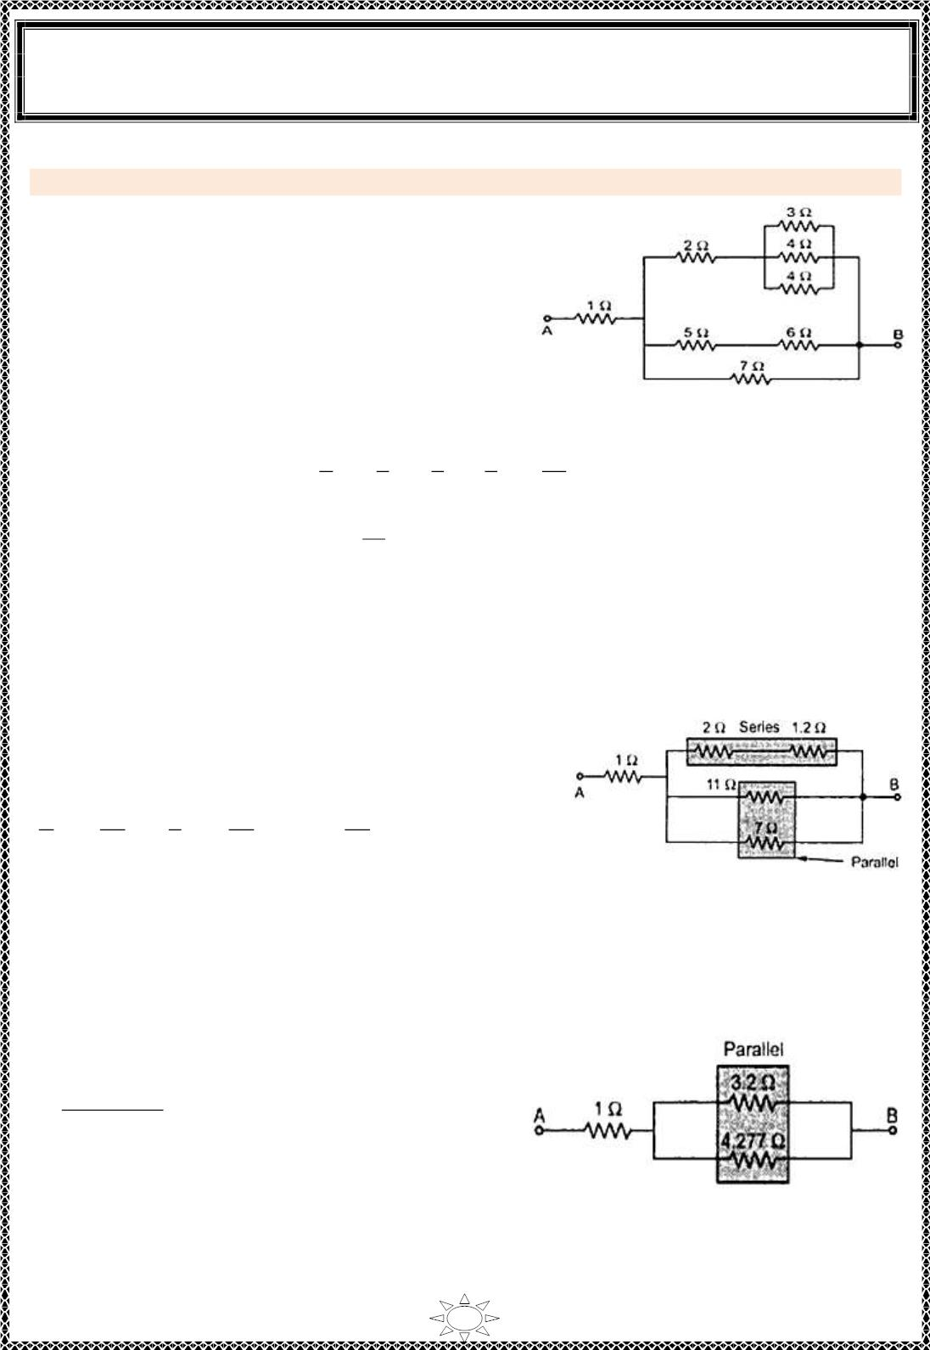
University of Diyala
Engineering College
Electronic Department
Electrical Engineering Fundamentals
1st Class
Asst., Lecturer : Wisam N. AL-Obaidi
Year (2013-2014)
Example 3: Find the equiva lent resistance between the two points A & B.
Solution:
The resistances of 5Ω and 6 Ω are in s er ies (as
carry the same current).
So equivalent res istance is 5+6 = 11 Ω
While res istances 3 Ω, 4 Ω, and 4 Ω are in parallel
(as voltage across them same but current divides).
Figure (2.6)(a)
1
R
1
3
1
4
1
4
10
12
∴ Eq uiv a len t resistance is,
= + + =
12
∴
R = = 1.2 Ω
10
Trail Version
Trail Version
Trail Version
Trail Version
Trail Version
Trail Version
Trail Version
Trail Version
Trail Version
Trail Version
Trail Version
Trail Version
Trail Version
Replac ing these c ombinat ions and redraw the f igure as shown in Figure (2.6)(b).
Now again 1.2Ω and 2 Ω are in s er ies so equivalent
resistance is 2+1.2=3.2 Ω, while 11 Ω and 7 Ω are in
parallel,
1
1
1
+ =
7
18
77
77
R
=
, ∴ R= = 4.277 Ω
11
18
Figure (2.6)(b)
Replac ing the respective c ombinat ions redraw the circuit as shown in Figure (2.6)(c).
Now 3.2 Ω and 4.277Ω are in parallel.
3.2×4.277
= 1.8304Ω
R=
3.2+4.277
∴ R_{AB} = 1 + 1.8304 = 2.8304Ω
Figure (2.6)(c)
20

